Slide 1

BUAN 6341 ANALYSIS OF CUSTOMER CHURN
BY GROUP-5:
Valerie Garcia
Patrick Ninan
Albin Poulose
Srivani Kakumani
Ashiq Mohammed Al Ameen

Slide 2
TABLE OF CONTENTS PROJECT OUTLINE
INTRODUCTION AND MOTIVATION
DATA EXPLORATION
LOGISTIC MODEL
DECISION TREE
COMPARISON AND ANALYSIS
CONCLUSION

Slide 3
INTRODUCTION AND MOTIVATION
Introduction
Project scenario:
A Data Science Coding project working with a real-world dataset to build a prediction or classification model. Python and Jupyter Notebook are used to tackle the problem, focusing on data manipulation, feature engineering, and model evaluation.
Summary:
Predicting whether subscriptions on a video stream platform will churn. This can help platform managers assess current and future tactics to keep and gain more viewers.

Slide 4
MOTIVATION:
what is customer churn?
Customer churn occurs when customers or subscribers stop doing business with a company or service, also known as customer attrition. It is also referred as loss of clients or customers.
What is churn analysis?
Churn analysis is the evaluation of a company’s customer loss rate in order to reduce it.

Slide 5
DATA EXPLORATION
We are using a Kaggle Dataset denoting Predictive Analytics for Customer Churn: Dataset (kaggle.com).
It consists of three files such as "test.csv", "train.csv", "data_descriptions.csv".
Train dataset contains 243,787 entries Each entry contains 21 columns in the training set, the test set did not contain the target variable "churn".

Slide 6
Columns :
CustomerID: Unique identifier for each customer
SubscriptionType: Type of subscription plan chosen by the customer (e.g., Basic, Premium, Deluxe)
PaymentMethod: Method used for payment (e.g., Credit Card, Electronic Check, PayPal)
PaperlessBilling: Whether the customer uses paperless billing (Yes/No)
ContentType: Type of content accessed by the customer (e.g., Movies, TV Shows, Documentaries)
MultiDeviceAccess: Whether the customer has access on multiple devices (Yes/No)
DeviceRegistered: Device registered by the customer (e.g., Smartphone, Smart TV, Laptop)
GenrePreference: Genre preference of the customer (e.g., Action, Drama, Comedy)
Gender: Gender of the customer (Male/Female)
ParentalControl: Whether parental control is enabled (Yes/No)
SubtitlesEnabled: Whether subtitles are enabled (Yes/No)
AccountAge: Age of the customer's subscription account (in months)
MonthlyCharges: Monthly subscription charges
TotalCharges: Total charges incurred by the customer
ViewingHoursPerWeek: Average number of viewing hours per week
SupportTicketsPerMonth: Number of customer support tickets raised per month
AverageViewingDuration: Average duration of each viewing session
ContentDownloadsPerMonth: Number of content downloads per month
UserRating: Customer satisfaction rating (1 to 5)
WatchlistSize: Size of the customer's content watchlist

Slide 7
No missing values or duplicates were found.
Monthly charges, total charges, viewing hours per week, average viewing duration, and user rating for every customer is unique.
Not even two customers had the same value for the features stated above, which is interesting!

Slide 8
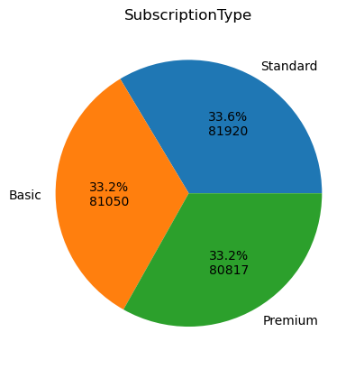
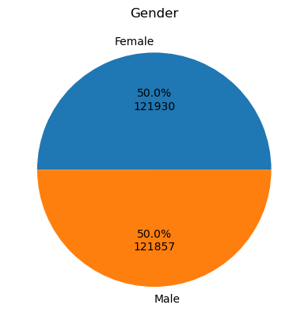
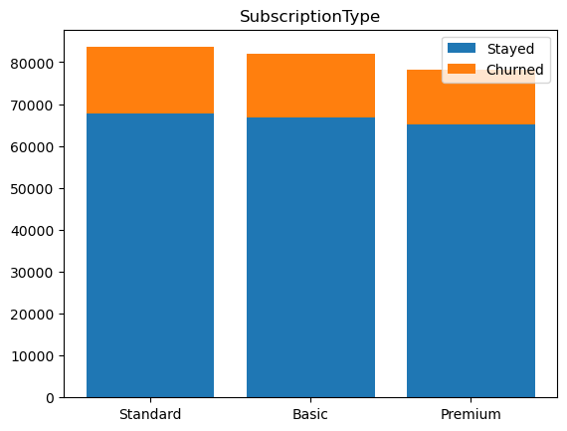
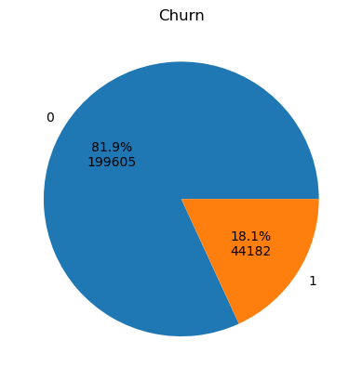
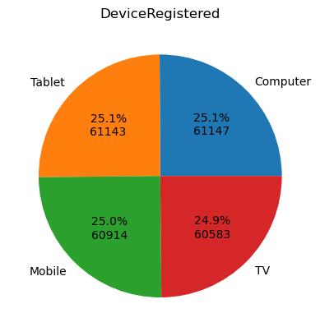
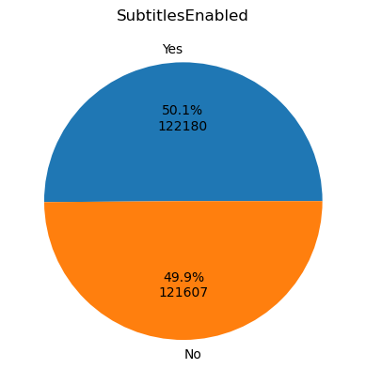
Comparison of churned and stayed customers based on categorical columns, we can identify differences in their characteristics.
By analyzing subscription types, we can compare churned and retained customers to discern any notable differences.
ii
i

Slide 9
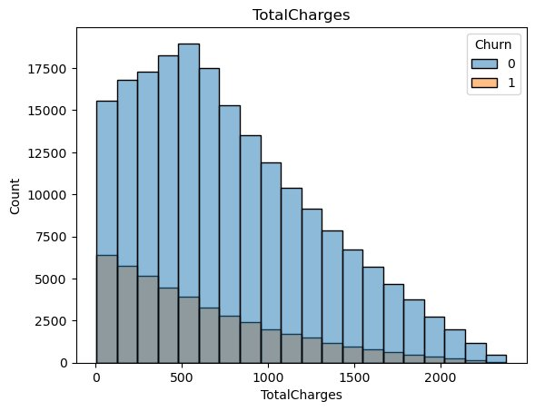
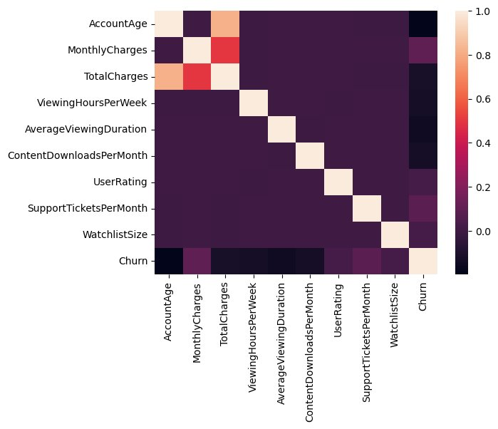
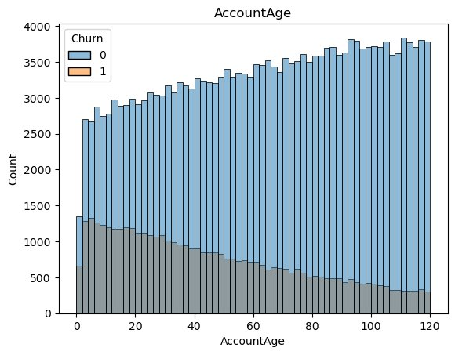
THE HEATMAP DISPLAYS CORRELATIONS BETWEEN VARIABLES, REVEALING A STRONG CORRELATION BETWEEN ACCOUNT AGE AND TOTAL CHARGES.
OBSERVING THE OVERLAP IN GRAPHS FOR CHURNED AND RETAINED CUSTOMERS REGARDING TOTAL CHARGES AND ACCOUNT AGE HIGHLIGHTS SIMILARITIES IN SPENDING BEHAVIOR OVER TIME.

Slide 10
Introduction To the models
Logistic Regression:
Logistic regression is a statistical method used for binary classification. It's commonly used when the dependent variable is binary, meaning it has only two possible outcomes. For example, it can be used to predict whether an email is spam or not spam, whether a student passes or fails an exam, or whether a customer will buy a product (yes/no).
​Decision Tree:
Decision tree is usually used for classification. As its name suggests, a decision tree simulates the basic structure of a tree for classification, including a root node, some internal nodes and leaves. Among them, each leaf node corresponds to a predicted result, while the sample data in each node will be allocated to the corresponding child nodes according to the results of attribute tests.​

Slide 11
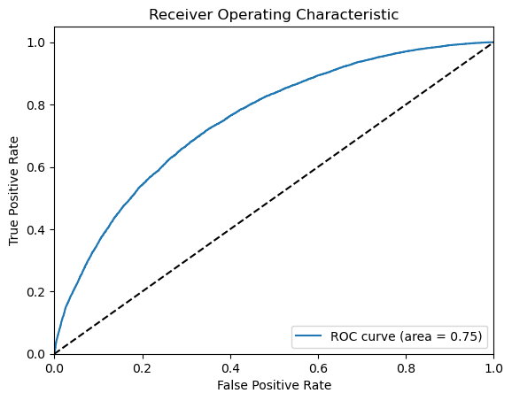
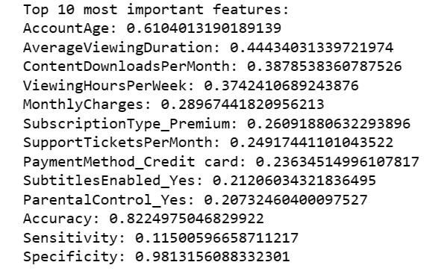
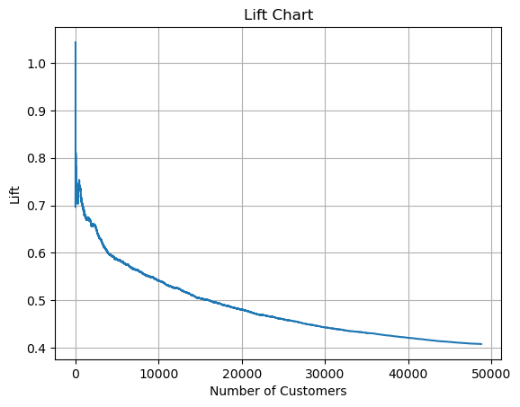
LOGISTIC REGRESSION
Accuracy: 0.6778374830796997 Sensitivity: 0.6964732650739477 Specificity: 0.6737389911929543

Slide 12
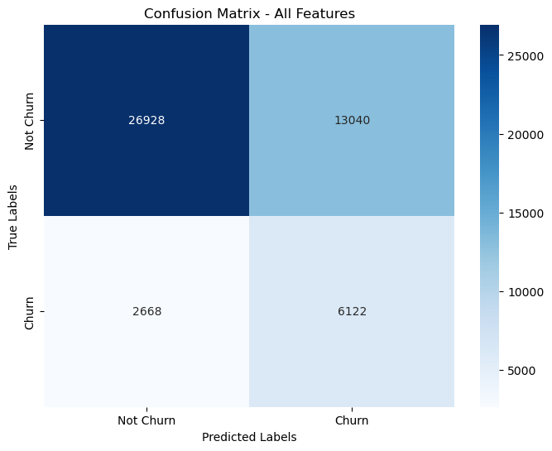
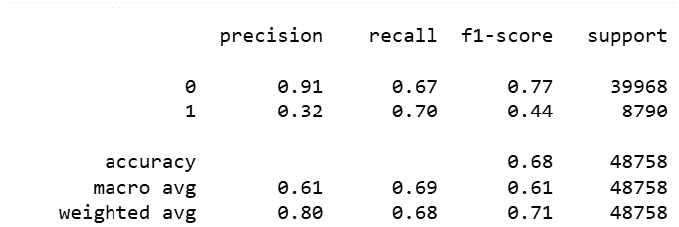
Confusion matrix
Report

Slide 13
Decision Tree
We used a cart decision tree algorithm to predict the churn. Early stopping with cross validation was used to prevent overfitting

Slide 14
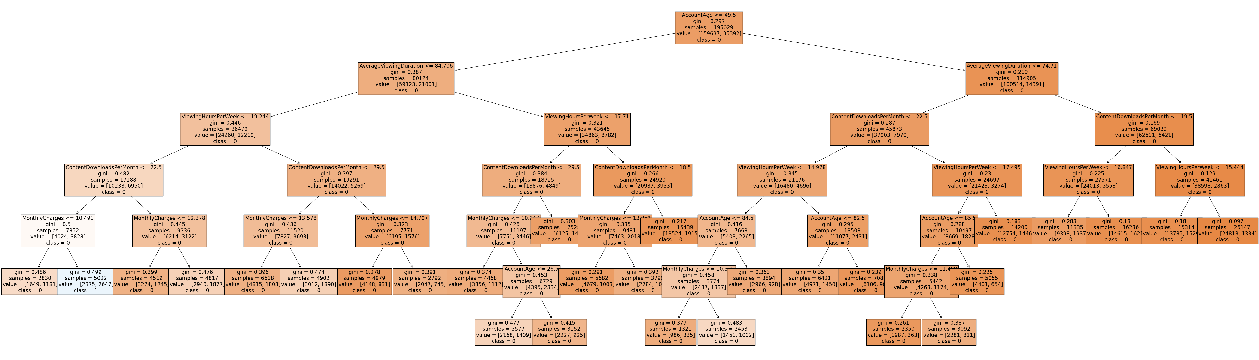
Account Age <= 49.5
Average Viewing Duration <= 84.706
Viewing Hours Per Week <= 19.244
Content Downloads Per Month <= 22.5
Monthly Charges > 10.491

Slide 15
Oversampling
No pre-processing
Accuracy - .82
Sensitivity - .07
Specificity - .99
With over-sampling
Accuracy - .64
Sensitivity - .69
Specificity - .63

Slide 16
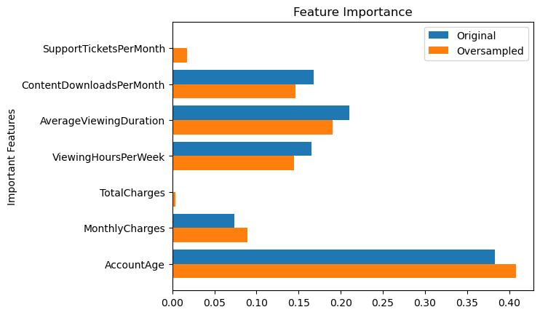
Feature importance

Slide 17
COMPARISION BETWEEN THE TWO MODELS
LOGISTIC REGRESSION
Accuracy- 0.68
Sensitivity- 0.70
Specificity- 0.67
DECISION TREE
Accuracy - 0.64
Sensitivity - 0.69
Specificity - 0.63
We prefer Logistic Regression because it outperforms the decision tree in accuracy and sensitivity.

Slide 18
Conclusion:
Top Five Features:
Account Age
Average Viewing Duration
Content Downloads Per Month
Viewing Hours Per Week
Monthly Charges
We should focus on newer accounts with lower engagement (viewing duration, content downloads per month, viewing hours per week). Target them with focused content to increase engagement. We should also try to decrease monthly charges for newer customers with low engagement in order to prevent churn.

Slide 19


